Slide 1
Employment-Related US Permanent visas:Applicant attributes
Sanaz Jamloo, Sangeeta Nandi, Omer Orhan (alphabetical order)

Slide 2
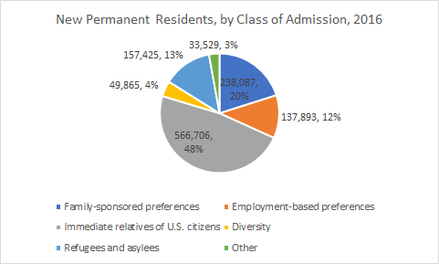
Topic and team (A strong correlation!)
The DOL processes Permanent Work visas to live and work in the US, subject to legal and procedural conditions
These are central to the American immigration story in the Silicon Valley economy - and our Team!
The Big Picture:
Employment-based visas only 12 % of approx. 1.8 million permanent immigrants in 2016.
Family-based immigration tops the chart, averaging around 50% over the years.
Santa Clara City has the highest number of employers that hired foreign employees in CA (2nd largest in the the country)
Notes:
DOL: Department of Labor
Pie chart from DHS (Department of Homeland Security) Data

Slide 3

PROJECT approach
The overarching goal of the project is to analyze key worker-related attributes, example wage levels, or economic sector, and their relationship with permanent visa applications (outcomes-focused)
Central Hypothesis: Positive work visa outcomes are influenced by economic sector and wages (as a proxy variable that showcases higher education levels and and skills-intensive in-demand jobs)
But, a prevalence of categorical variables, which is why the ols regression exercise predicts if:
Wages of visa applicants are favourably influenced by the economic sector, state, etc.
And so we approach the data to:
-Explore, Diagnose, Predict Relationships
(Base R, dplyr, ggplot2, readr)

Slide 4

About the data:Overview
Source: Dataset (ZIP file) on permanent work visa applications from Kaggle.com
Kaggle attributes the Department of Labor as its source
Dataset includes info on final decision, wages, employers, state, visa past history, economic sector
Per Kaggle: the dataset provides information on “374K visa decisions” from 2012-2017
Downloading and importing the dataset into R:
> us_perm_visas <- read_csv("Data Analysis - R/Project/us_perm_visas.csv")
> dataset<-us_perm_visas
> dim(dataset)
[1] 374362 154
> str(dataset)
Classes ‘tbl_df’, ‘tbl’ and 'data.frame':
374362 obs. of 154 variables
Datasize and Timeframe
374,362 observations in 154 columns
Observations from 2011 - 2016 (not 2012 - 2017)
Notes:
9089 is the form distributed by the United States Government Department of Labor so foreign employees can get permanent work approval. (wage variables are as reported in 9089)
In addition, we have also looked at news articles on immigration research, and government data to get a better understanding of the overall immigration and permanent worker visa context in the US. Includes DHS and DOL + news articles

Slide 5

About the data: subset of project variables
>dataset<-subset(dataset,select=c("country_of_citzenship","case_status","class_of_admission","decision_date","employer_city","employer_state","wage_offer_from_9089","us_economic_sector"))
country_of_citizenship
case_received_date
case_status (process decision)
class_of_admission (prior visa)
decision_date
employer_city
employer_state
8. Worker_birth_country 9. Foreign_worker_education 10. Foreign_worker_info_major 11. Wage_offer_from_9089 12. Wage_offer_unit_of_pay_9089 13. us_economic_sector
> sapply(dataset,class): 1 Date variable, 1 numeric variable, 11 character variables
Checking column observations through unique observations, and visuals:
4 variables (in orange) omitted due to no data
An additional variable (blue) included for consistency in unit of wage information

Slide 6

Did you know? (A Very Big picture)
Workers from 159 countries applied for permanent visas from 2011-2016
They work in a total of 17 economic sectors
spread across 5606 unique locations/cities (or, not - see below)
and 113 US States (no, really!) - which is how we got looking deeper (e.g., California and CA, also US territories like Marshall Islands)
And yes, there were 57 categories of prior visas (57?!!)
Code examples:
> colnames(dataset)=c("COUNTRY", "STATUS","VISA","DATE","CITY","STATE",
"WAGE","INDUSTRY") #Changing column names
> unique(dataset$STATUS) #unique column observations > length(unique(dataset$STATE)) #number of unique observations > plot(dataset$WAGE)) #visual spread of observations
Notes:
H1-B, but also TPS and H-2B
> unique(dataset$VISA)
[1] "J-1" "B-2" "H-1B" "L-1" "EWI" "E-2" "" "E-1" "H-2B" "TPS"
[11] "F-1" "B-1" "C-1" "Not in USA" "TN" "H-4" "O-1" "R-1" "L-2" "Q"
[21] "F-2" "H-1B1" "Parolee" "G-5" "E-3" "H-2A" "VWT" "P-1" "A1/A2" "D-1"
[31] "A-3" "R-2" "H-1C" "H-3" "J-2" "P-4" "I" "H-1A" "G-1" "VWB"
[41] "G-4" "P-3" "AOS/H-1B" "O-3" "Parol" "O-2" "H1B" "N" "T-1" "TD"
[51] "M-1" "K-1" "U-1" "AOS" "P-2" "C-3" "V-2"
> unique(dataset$INDUSTRY)
[1] "IT" "Other Economic Sector" "Aerospace" "Advanced Mfg" "Educational Services"
[6] "Retail" "Construction" "Hospitality" "Automotive" ""
[11] "Health Care" "Agribusiness" "Finance" "Energy" "Transportation"
[16] "Homeland Security" "Biotechnology" "Geospatial"
Advanced manufacturing involves the use of technology to improve products and/or processes: Computer technologies, robotics, sustainable/green technologies
> colnames(dataset)=c("COUNTRY", "STATUS","VISA","DATE","CITY","STATE","WAGE","INDUSTRY")

Slide 7
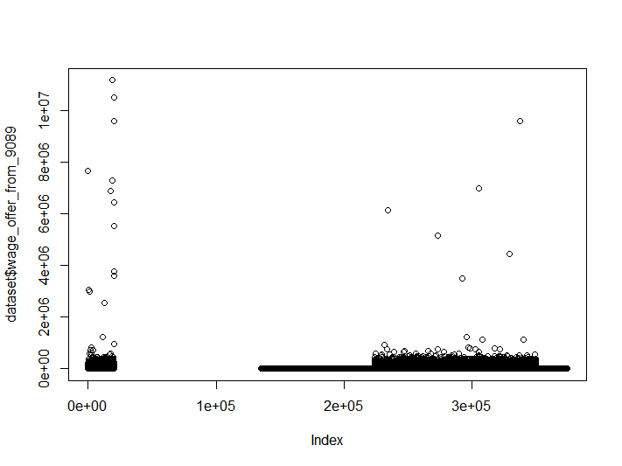
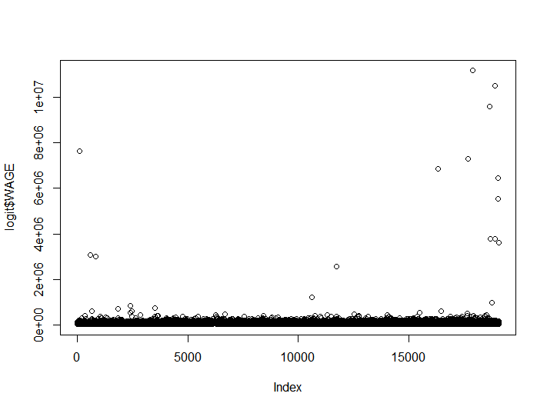
The wage variable: a Deep dive
> 250324-19104
[1] 231220
Full dataset: 11 unique wage observations, including “NA”,”yr”,”Year”,”mth”,”wk”,”bi”
> summary(wage_offer_from_9089$dataset) Min. 1st Qu. Median Mean 3rd Qu. Max. NA's
1 68557 90750 91224 114296 11175840 224718
>wage_yr<-subset(dataset,wage_offer_unit_of_pay_9089=="yr"|wage_offer_unit_of_pay_9089=="Year",select=c("wage_offer_from_9089","us_economic_sector", "wage_offer_unit_of_pay_9089", "case_status","decision_date",”country_of_citzenship:)) #select yearly wage observations
> wage_final<-wage_yr[complete.cases(wage_yr),] #removing NA
> summary(wage_final$wage_offer_from_9089) Min. 1st Qu. Median Mean 3rd Qu. Max.
15142 68458 85176 95109 105934 11175840
Outliers > outliers<-wage_final[wage_final$wage_offer_from_9089 >162147.6> dim(outliers) [1] 940 6
Notes:
> ylow
[1] 12244.38
> yup
[1] 162147.6
Y axis: wages
X axis: applicant count

Slide 8

Predicting for visa outcomes (?!)
Hypothesis: Visa outcomes=f(Wages, Industry, Applicant Country) - a logistic effort
Convert Visa Processing “Status” to Binary Variable: Certified=1, Others=0 > logit$STATUS[logit$STATUS == "Certified"] <- 1 > logit$STATUS[logit$STATUS == "Denied"] <- 0 > logit$STATUS[logit$STATUS == "Expired"] <- 0 > logit$STATUS[logit$STATUS == "Certified-Expired"] <- 0 > logit$STATUS[logit$STATUS=="Withdrawn"]<-0
Ensure the converted binary variable is numeric > lookup <- c("0" = 0, "1" = 1) > logit$STATUS<-lookup[logit$STATUS] > class(logit$STATUS) [1] "numeric"
Run, and Run...
Model specification (select) | >summary(mylogit) [1]overviews
> mylogit <- glm(STATUS ~ WAGE+INDUSTRY+COUNTRY, data = logit, family = "binomial") (Wage, Industry, Country) | 6 INDUSTRY coefficients significant, model residuals include poor fit
> mylogit_wage <- glm(STATUS ~ WAGE, data = logit, family = "binomial") (Wage) | Only the intercept is significant
> mylogit_industry <- glm(STATUS ~ INDUSTRY, data = logit, family = "binomial") (Industry) | Intercept + 8 INDUSTRY coefficients significant, AIC score => model specification is marginally the best
Notes:
In inferential statistics, the null hypothesis is a general statement or default position that there is no relationship between two measured phenomena, or no association among groups. (We are unable to reject the null hypothesis)
No country coefficients significant (surprising, given the preponderance of certain countries in the Visa applications list - next step to look at truncated dataset (after clean up) and see if the country preponderance exists
> summary(mylogit)
Significant Coefficients only from Industry (not even intercept)
*** – Agribusiness, Construction, Homeland Security, Hospitality,
**Other Economic Sectors
*Transportation
> summary(mylogit_industry)

Slide 9
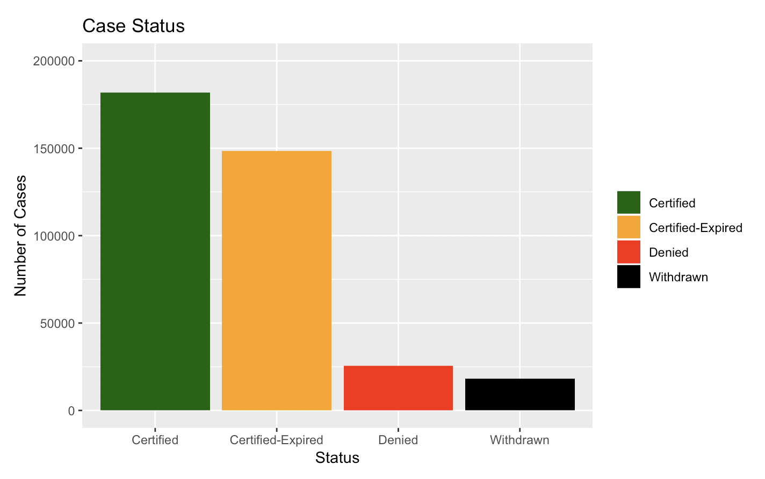
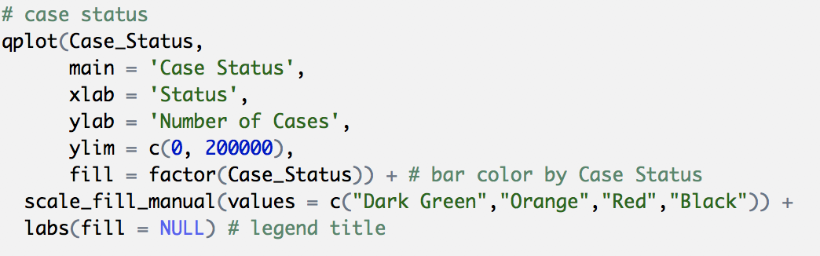
EXPLORING VARIABLES: Case Status
The relation between Case Status and Number of the Cases

Slide 10
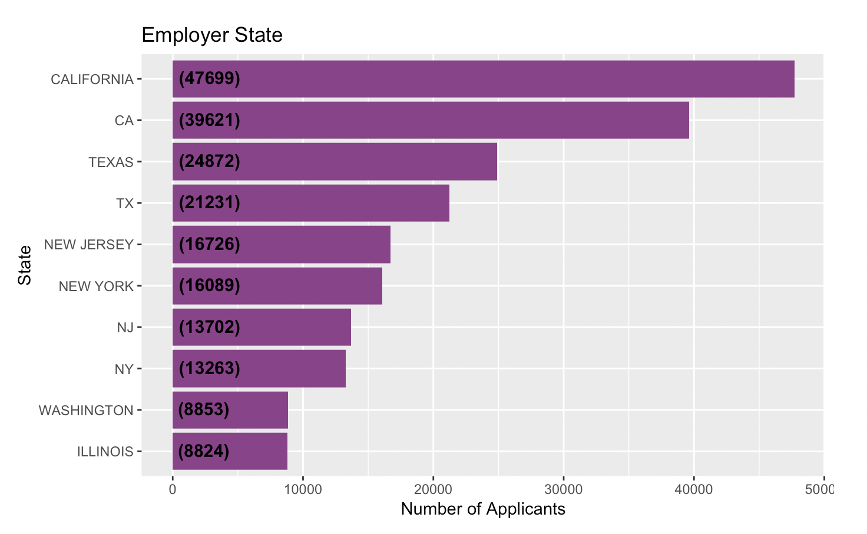
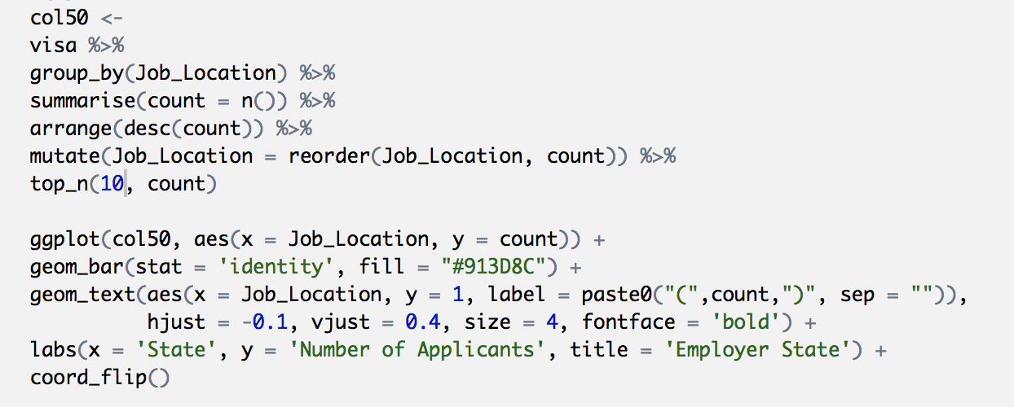
Exploring variables: EMPLOYER STATES
This graph shows top 10 employers by state

Slide 11
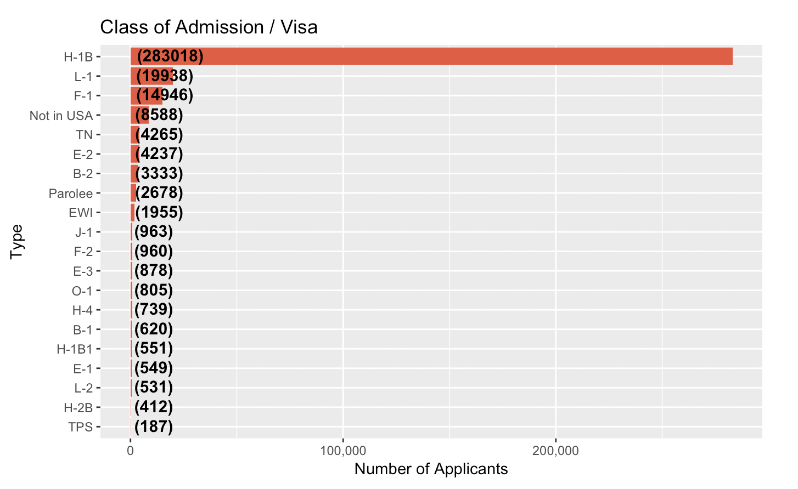
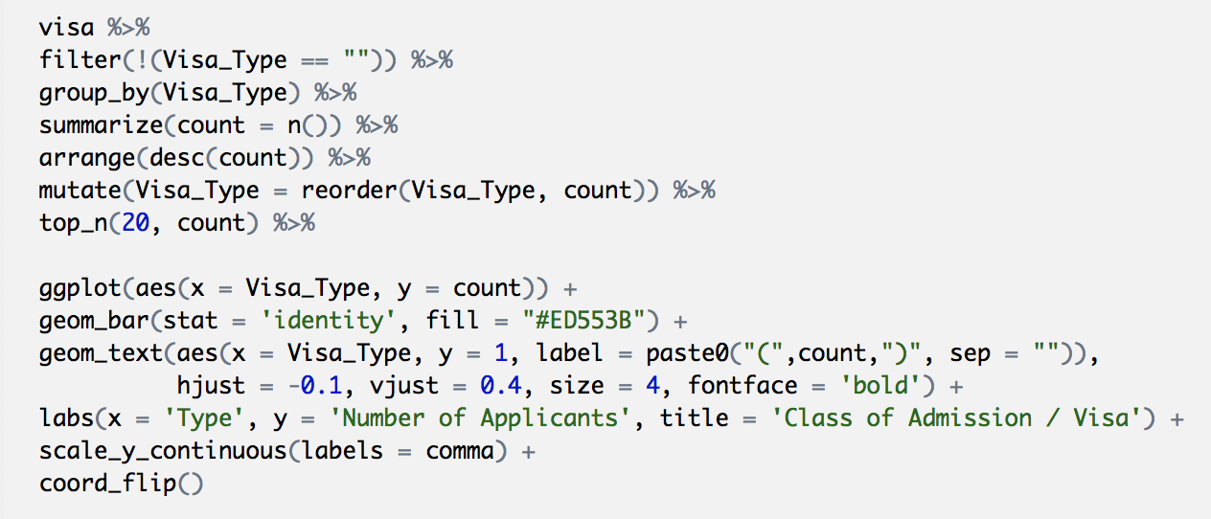
EXPLORING VARIABLES: Visa Types
Top 20 visa types that are processed to permanent worker status

Slide 12
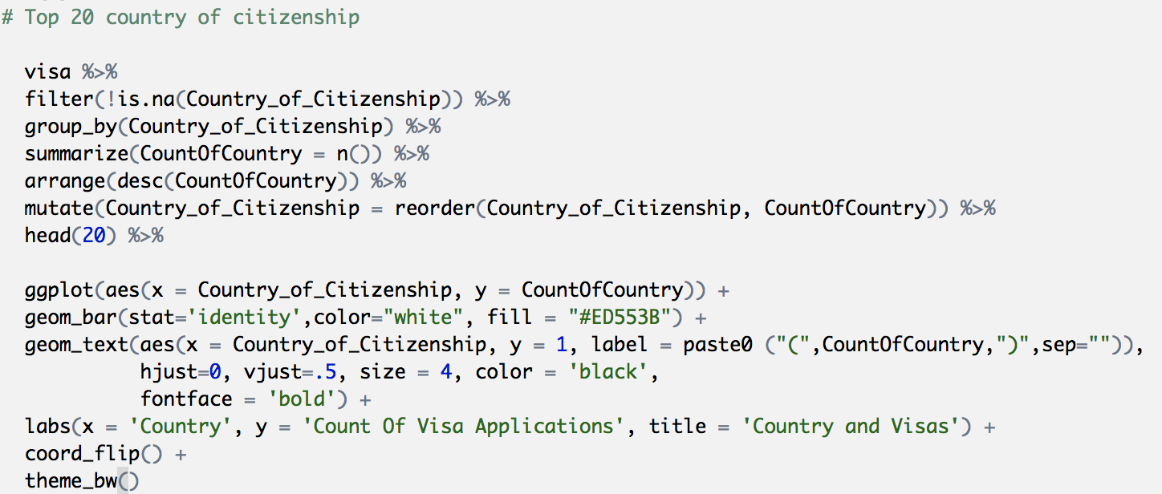
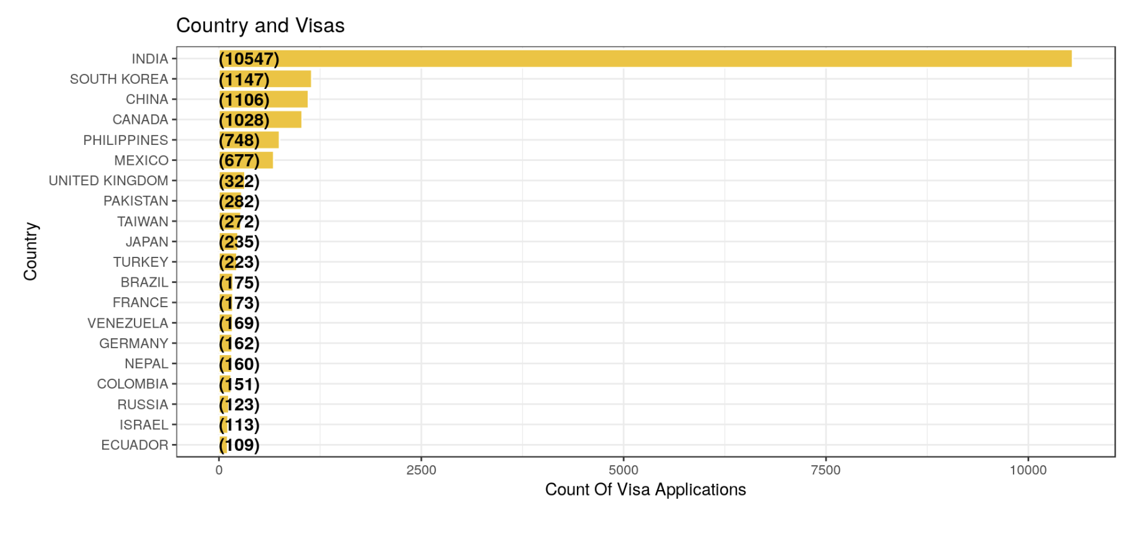
EXPLORING VARIABLES: Country of citizenship
Top 20 countries for permanent worker visa applications

Slide 13
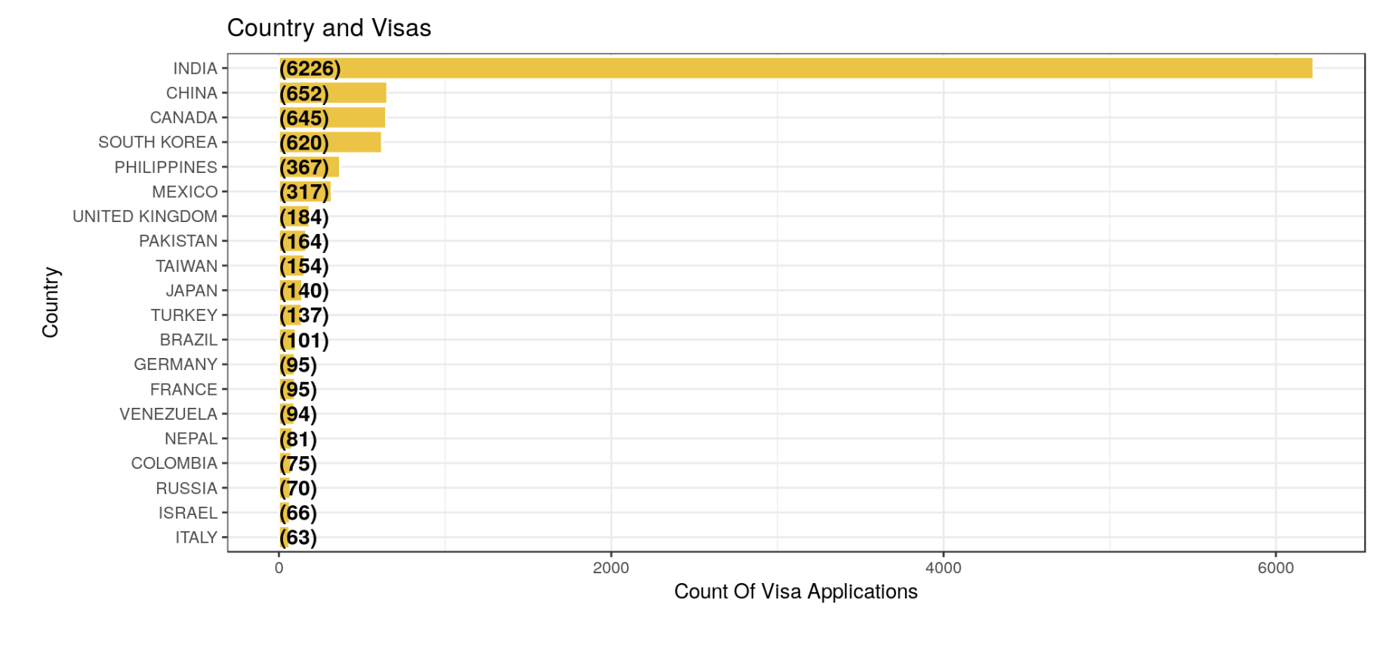
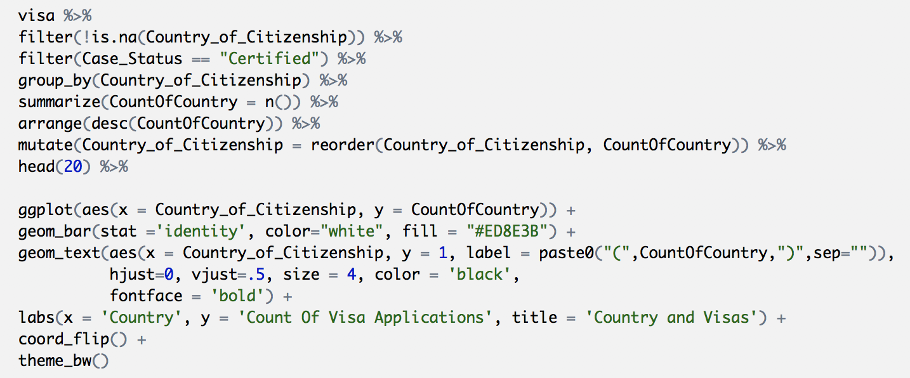
EXPLORING VARIABLES: Case status, certified
Top 20 Countries from which permanent work visas are Certified

Slide 14
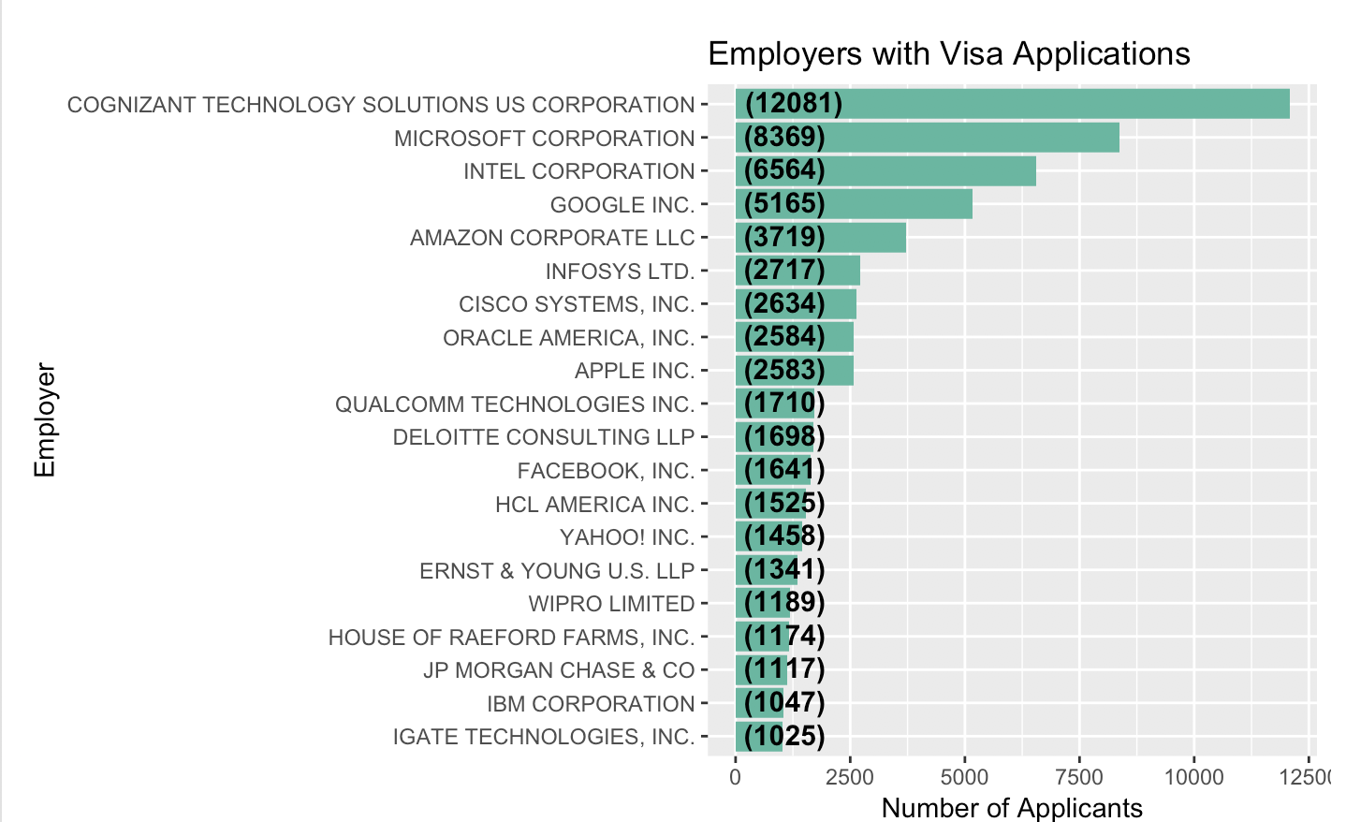
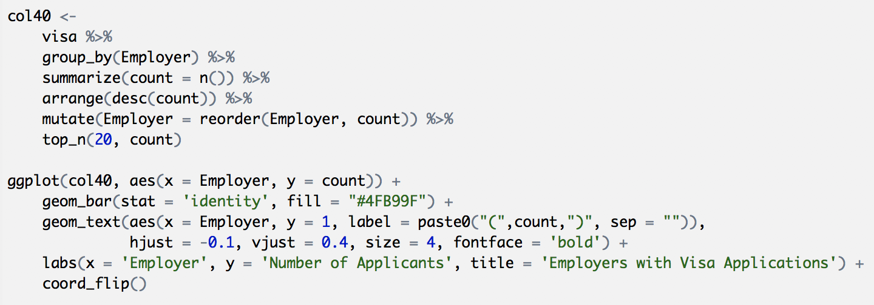
EXPLORING VARIABLES: Employers
Top 20 employers of permanent worker visa applicants

Slide 15
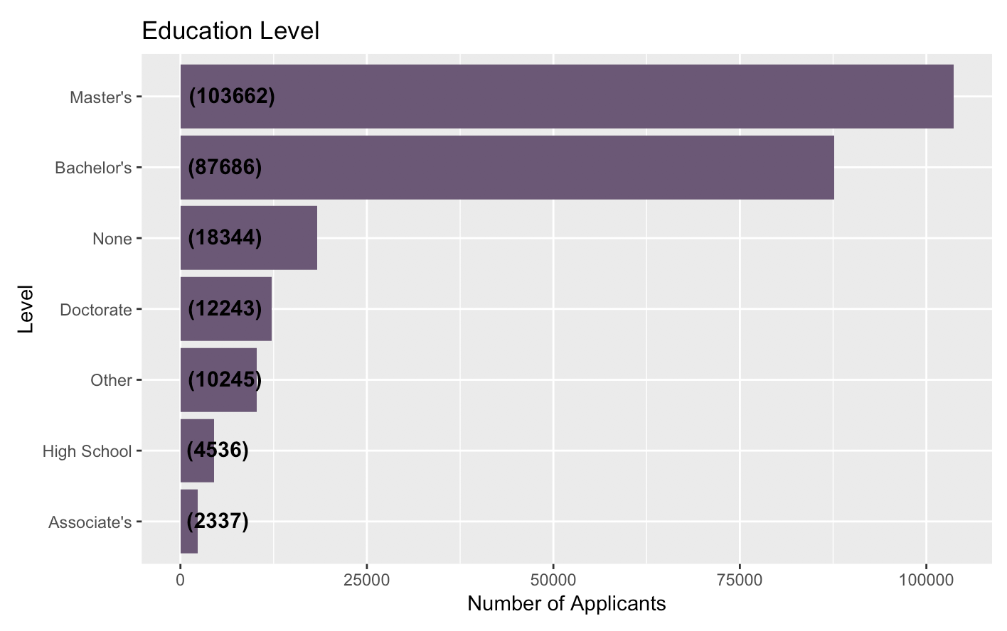
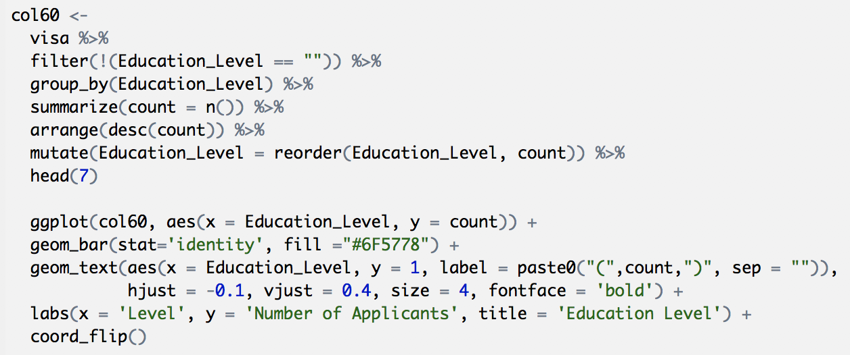
EXPLORING VARIABLES: Applicants’ education level
Education level of permanent visa applicants

Slide 16
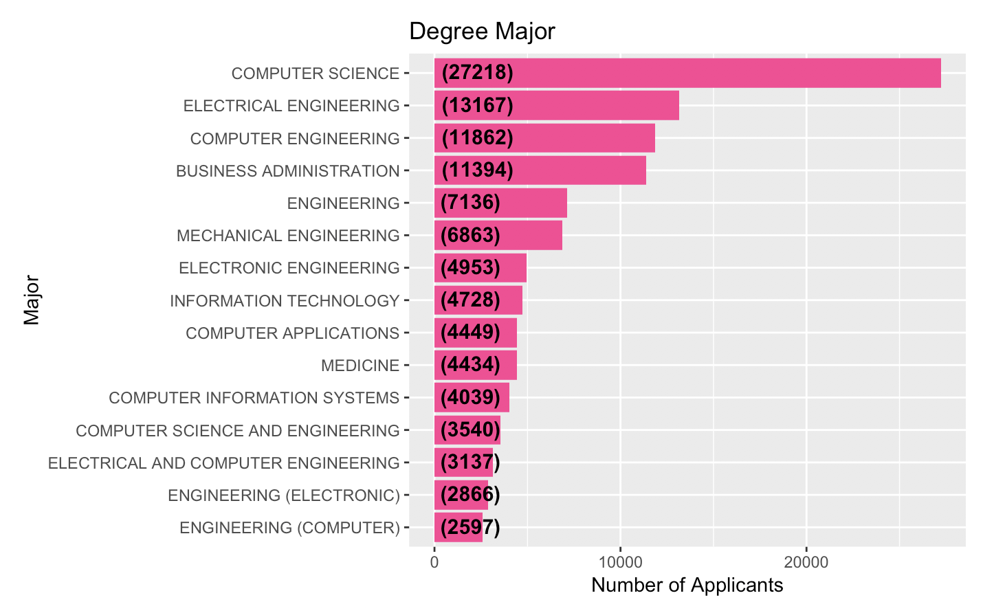
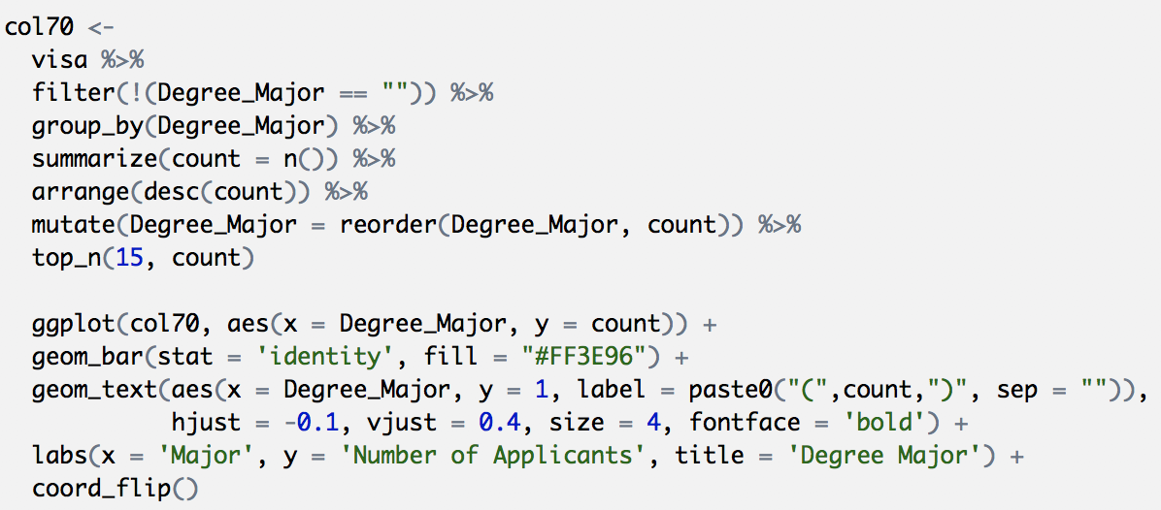
EXPLORING VARIABLES: Applicants Education
The major/field of study of visa applicants

Slide 17
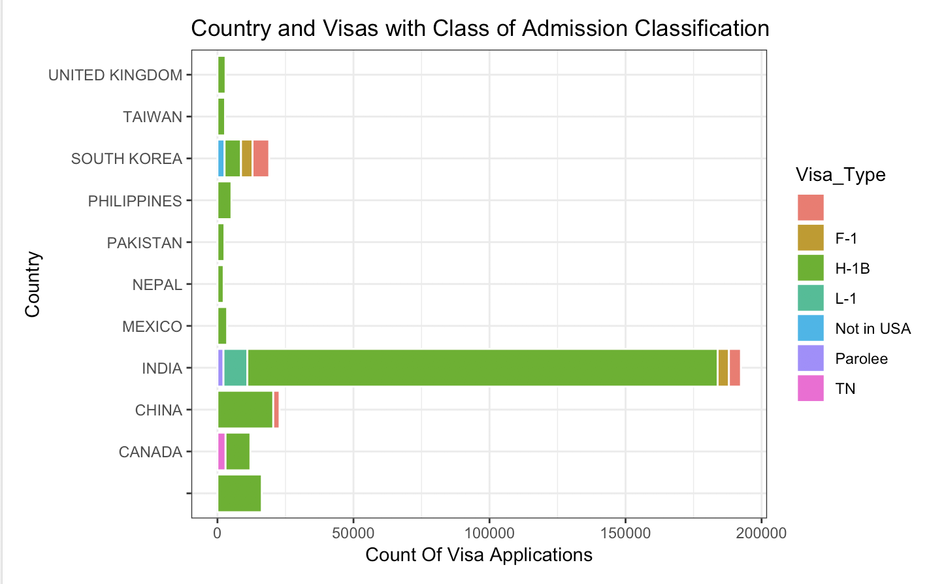
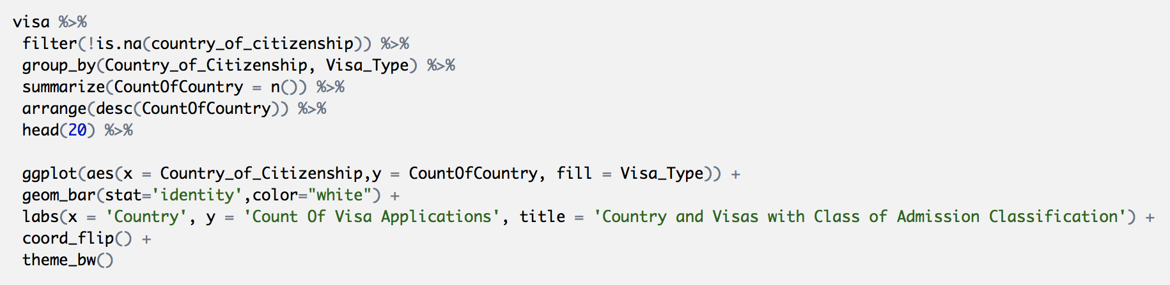
EXPLORING VARIABLES:class of admission
Visa applications by class of admission: top 20 countries with applicants

Slide 18
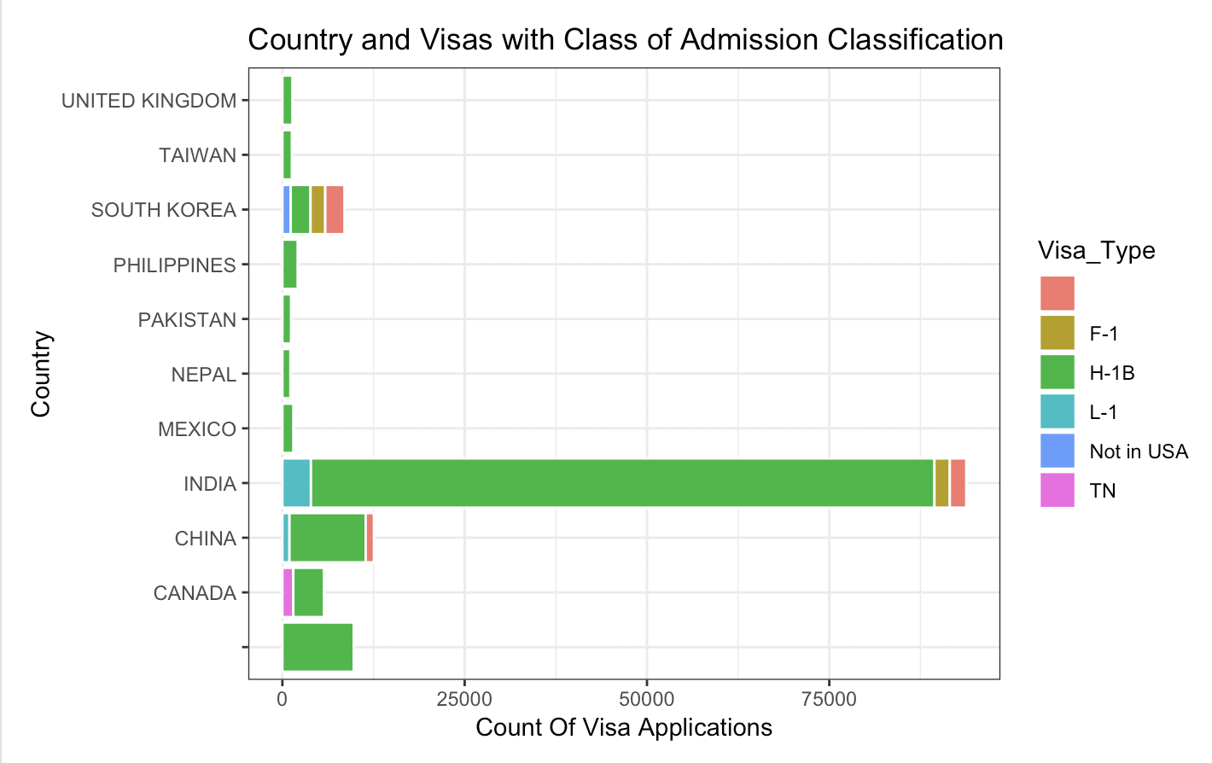
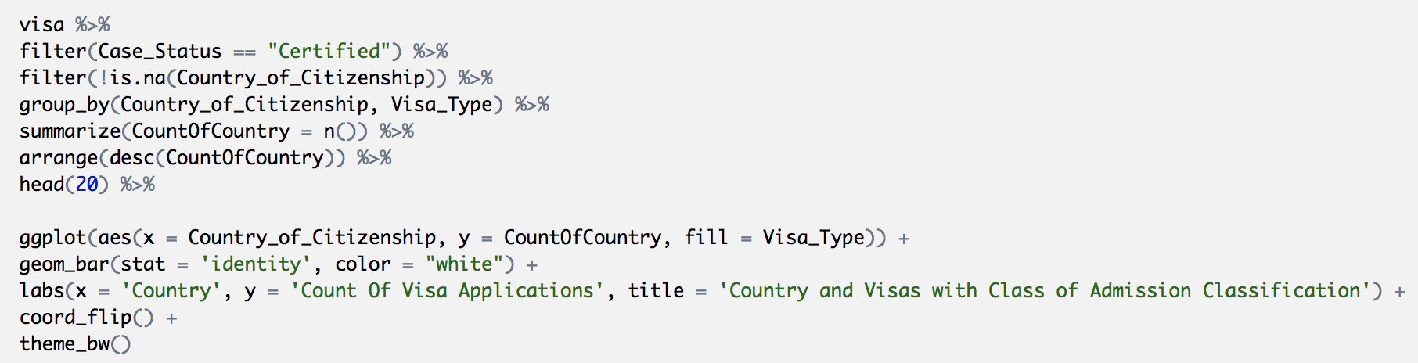
EXPLORING VARIABLES:class of admission-certified
Certified visa applications by class of admission: top 20 countries

Slide 19
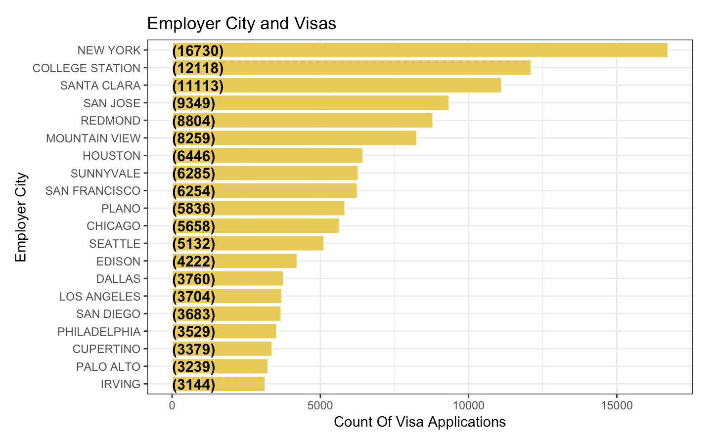
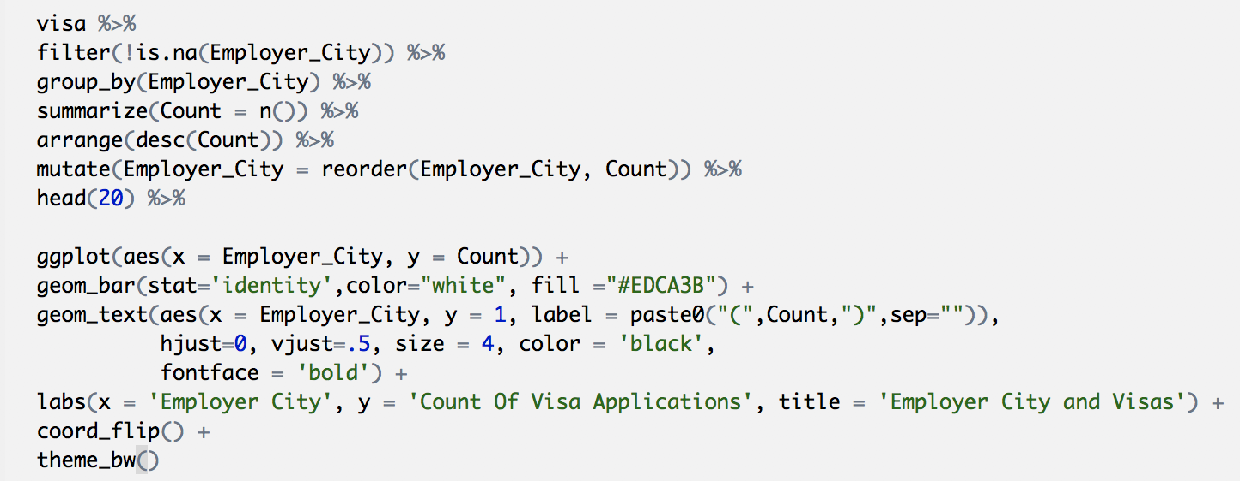
EXPLORING VARIABLES: Employer Cities
Top 20 cities that permanent worker applicants work in

Slide 20

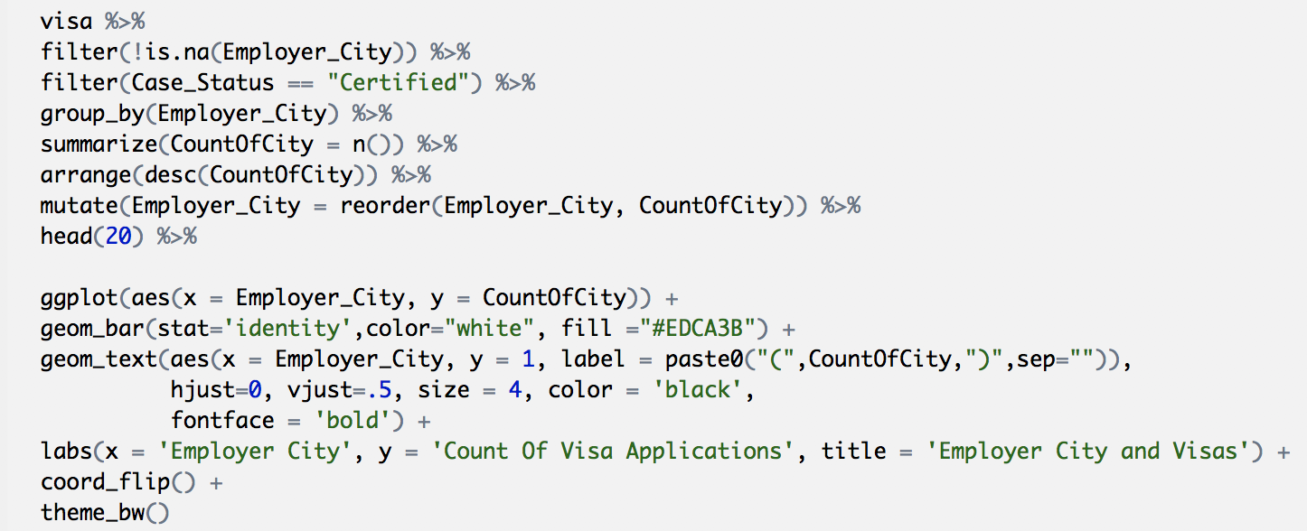
EXPLORING VARIABLES: Employer Cities (Certified)
Top 20 cities that certified permanent worker applicants work in

Slide 21
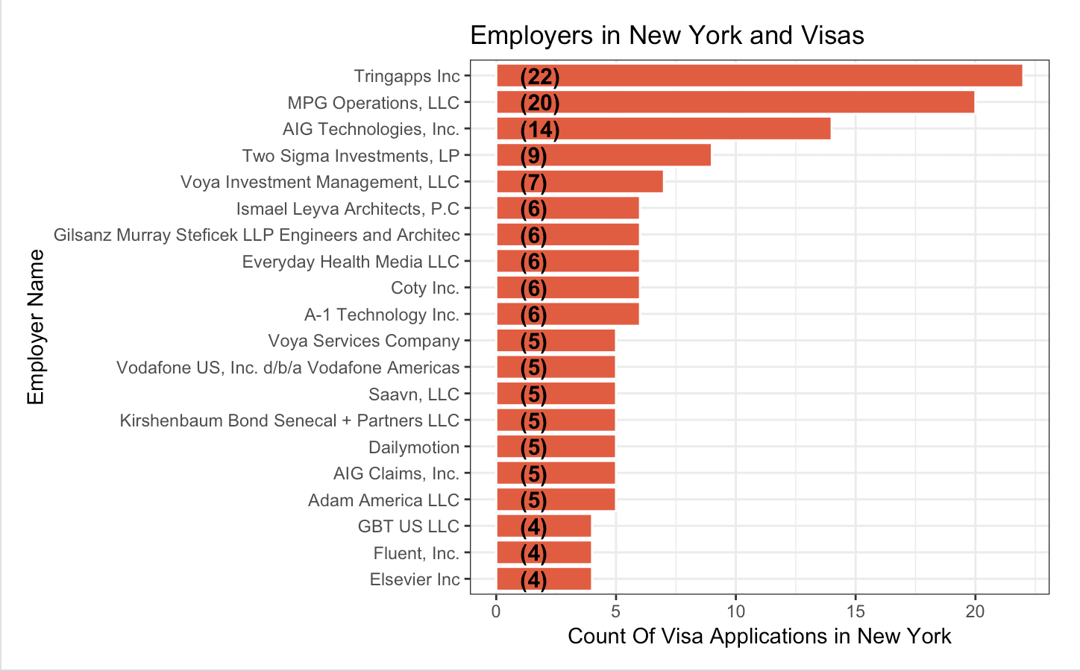
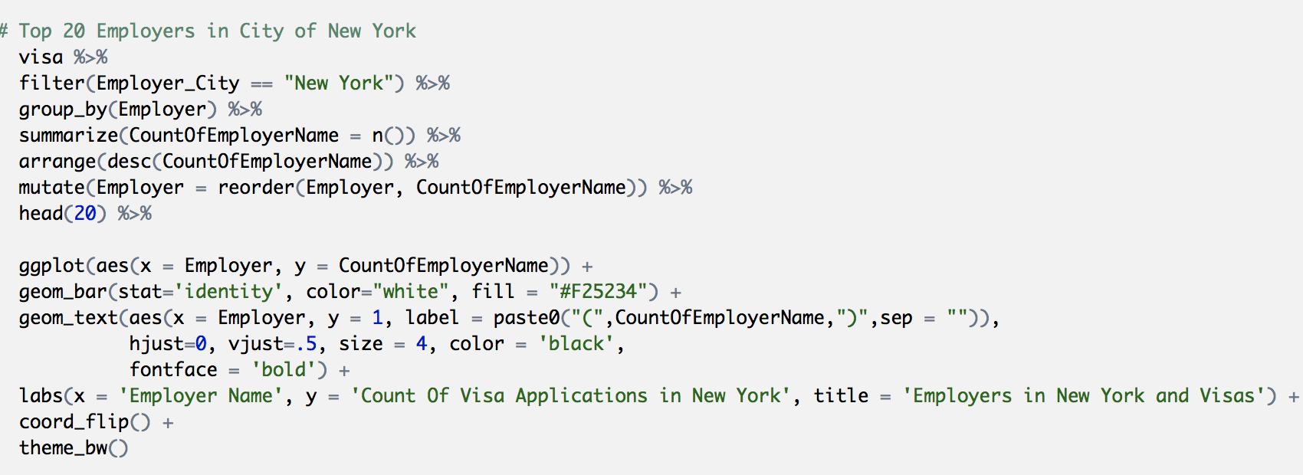
Employers in New YORK CITY (LARGEST EMPLOYER CITY)
Top 20 employers in New York City

Slide 22
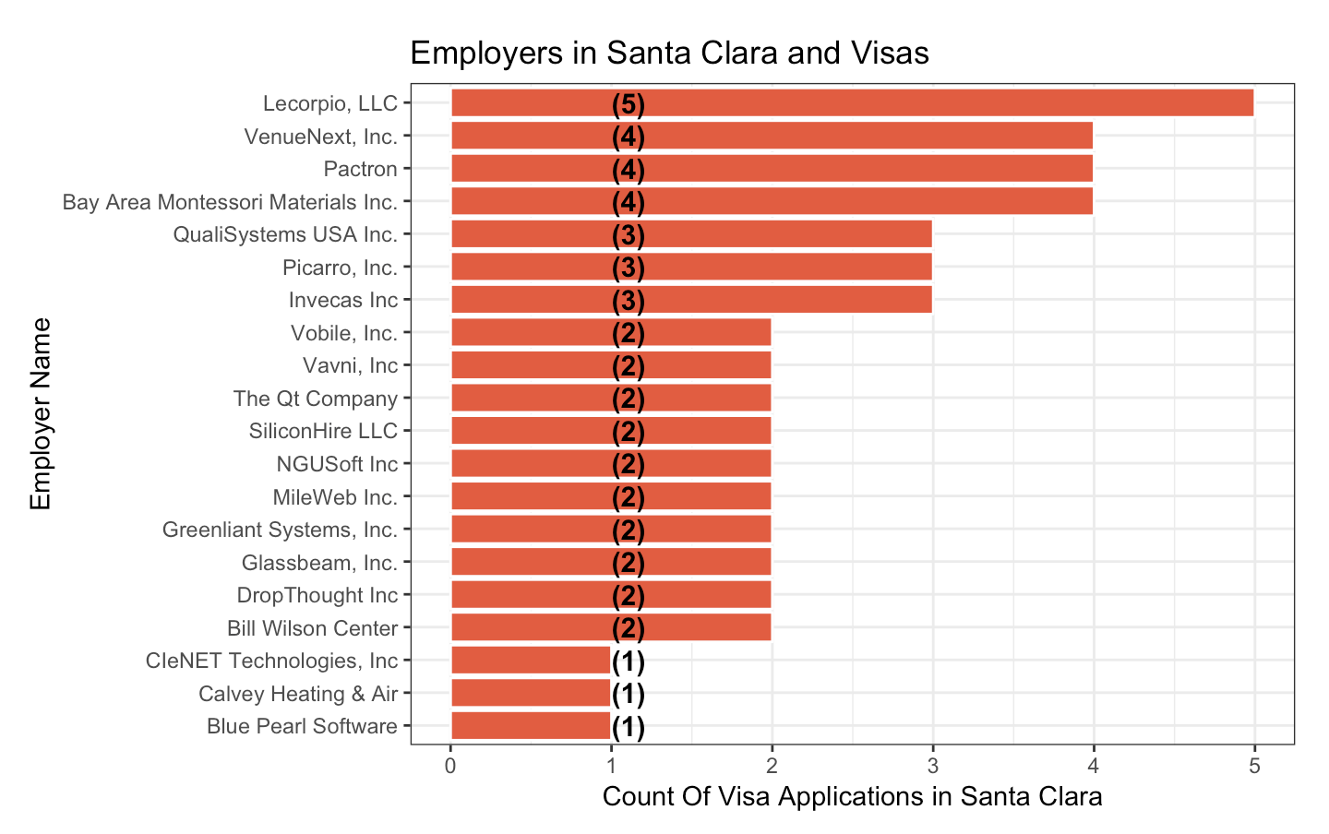
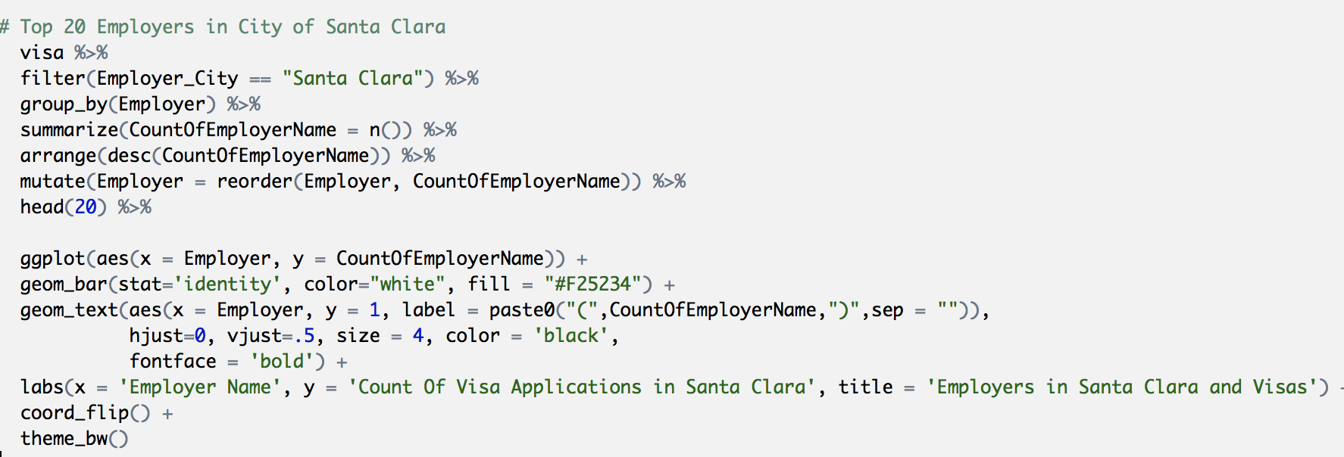
Employers in santa clara (2nd largest employer CITY)
Top 20 employers in city of Santa Clara City,CA

Slide 23
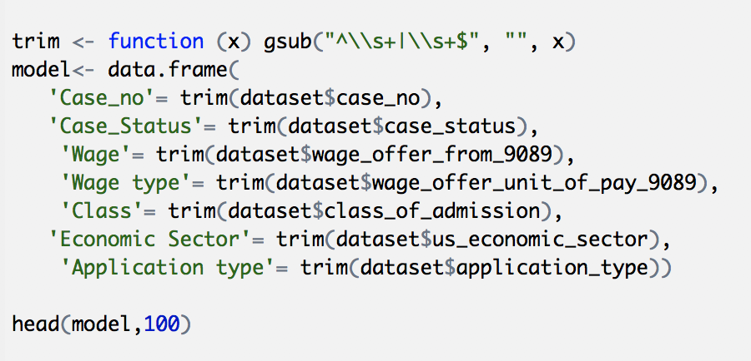
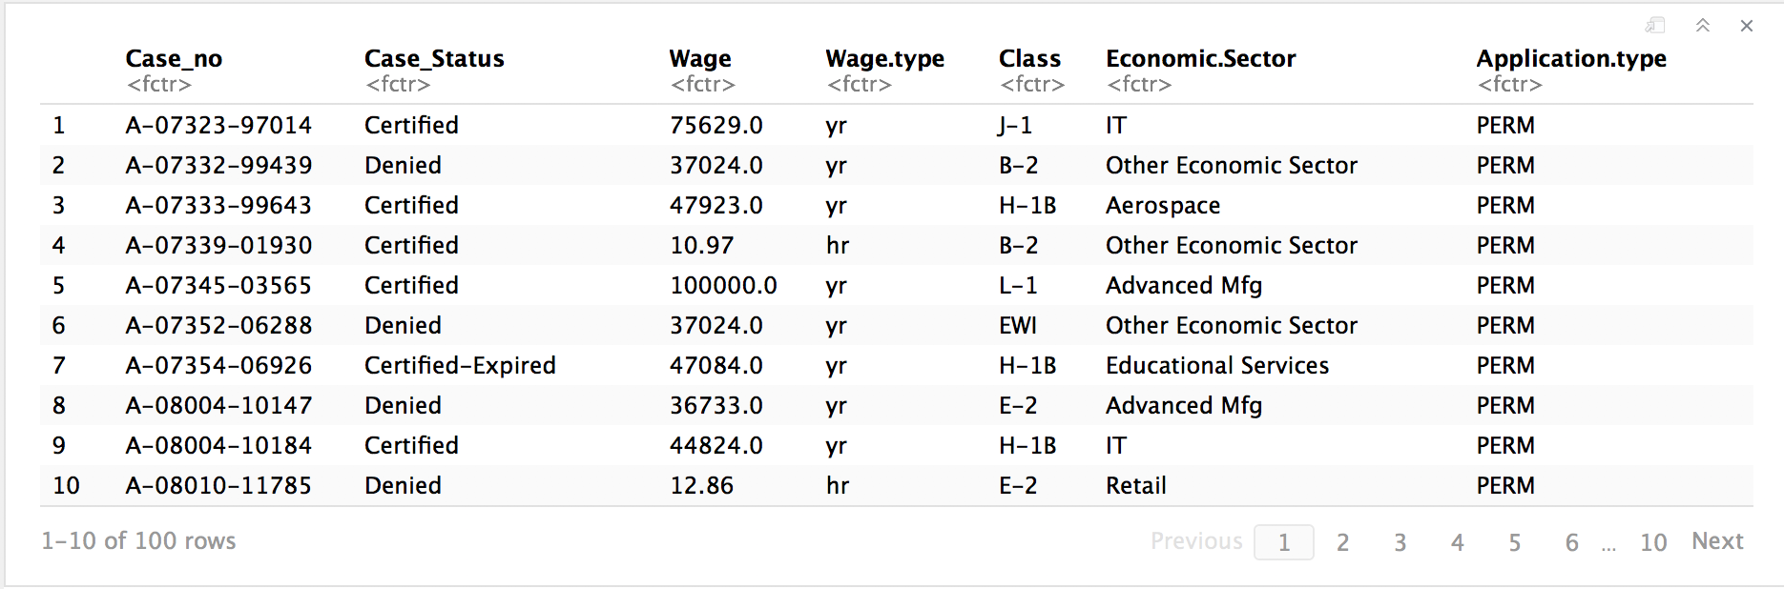
Variable relationships wages,year, state, sector
Preparing dataset for correlation matrix and subsequent modelling for data preparation, such as Case status, Wage, Wage unit, Economic sector, Application type and Class of admission have been considered. The employer name had too many levels,therefore, could not be considered. The variables shortlist was based on the type and class of the attribute. Those not considered had too many levels, or were repetitions, or simply empty lists.

Slide 24
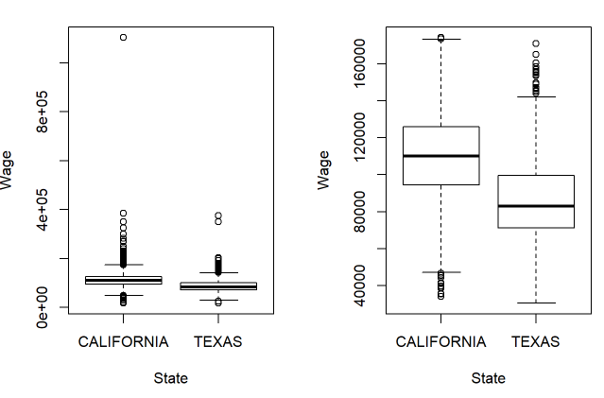
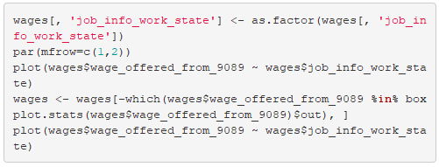
Calıfornıa&texas wages PLOT
mADSDADASDAD
California maximum wage:IT - $1.103.522
California maximum wage after boxplot:IT - $174.117

Slide 25
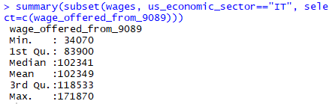
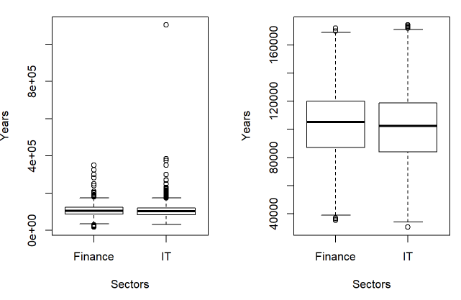
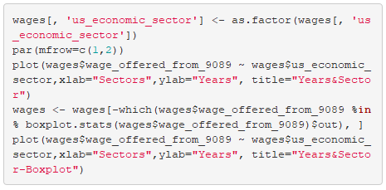
Fınance & ıt PLOT

Slide 26
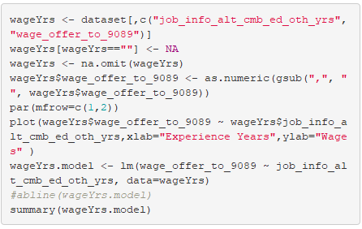
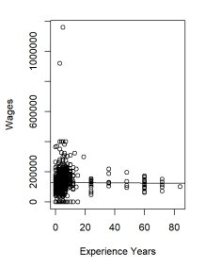
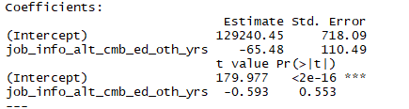
Salary & experıence prediction
Pr(>|t|) is greater than 0.05

Slide 27
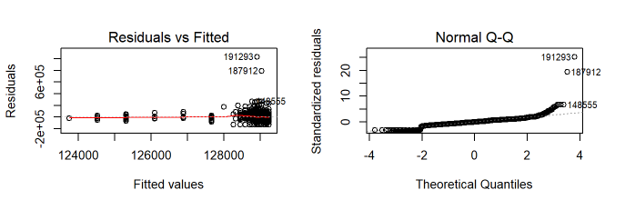
Salary & experıence prediction
If the linearity assumption is met, we should see no pattern here, the red line should be fairly flat
If our Y values or errors or residual terms are normally distributed, these points should fall roughly on a diagonal line.

Slide 28
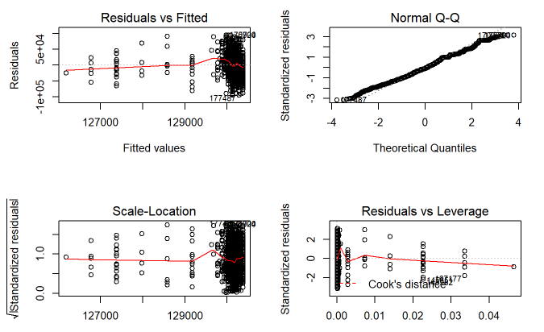
Salary & experıence prediction

Slide 29
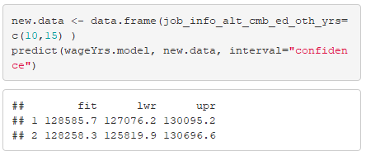
Salary & experıence prediction
predict.lm produces predicted values, obtained by evaluating the regression function in the frame newdata

Slide 30
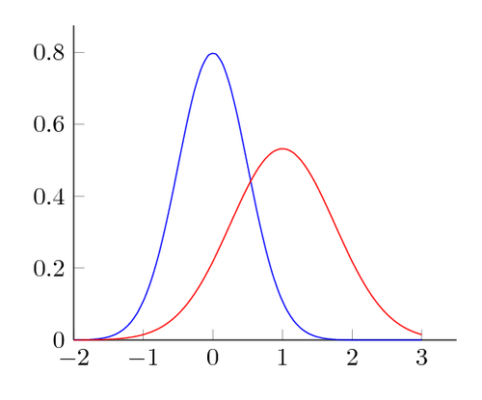
And we learnt (ON A LIGHTER NOTE)...
That data doesn’t lie
….but you can try to tell your own story through it
That data processing is intensive, and insightful
And that personal motivations do not necessarily lead to “Rome” (we wish our dataset had more numbers!)
Key data challenges
Missing information (e.g., we could use only 5% of total observations for gls)
Couldn’t carried out planned functions like creating a new variable
Categorical Variables
But! R works.
Notes:
Last bullet explanation: we were already in the game when we realized that we’d have preferred a dataset with more numeric variables, ours had only one that we could use (wage levels).

Slide 31
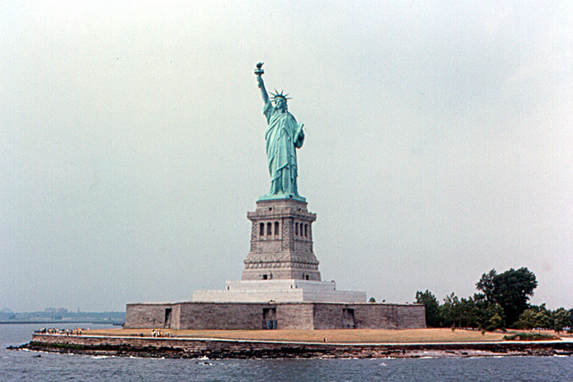
Thank You!
Dr. Gupta
Our Classmates
...And We Look Forward to
Comments and Questions

